Slide 1
Take Our Kids to Work Day
Safety Considerations

Slide 2
WCB Coverage
ARE KIDS WHO PARTICIPATE IN TAKE OUR KIDS TO WORK DAY COVERED BY WORKERS COMPENSATION?
Yes.
Participants in the Take our Kids to Work (TOKW) day are considered employees of the Province of Manitoba, and coverage is extended to all kids who are participating. TOKW students are entitled to workers compensation should any work related injury occur during the program.
WCB Manitoba, https://www.wcb.mb.ca/take-our-kids-to-work-day-frequently-asked-questions

Slide 3
WCB Coverage
ARE EMPLOYERS PROTECTED WHO HAVE KIDS ATTENDING TAKE OUR KIDS TO WORK DAY?
Yes, if the employer has WCB coverage.
TOKW participants are considered employees of the Province of Manitoba, and therefore employers with WCB coverage are protected from lawsuit should any work related injuries be sustained on this day. Employers who do not have WCB coverage are not immune from a lawsuit.
WCB Manitoba, https://www.wcb.mb.ca/take-our-kids-to-work-day-frequently-asked-questions

Slide 4
Young Worker Readiness Certificate Course
Kids participating in Take Our Kids to Work day must receive an orientation that includes safety. You may have an in-house orientation ready to go. If you need a different option consider the Young Worker Readiness Certificate Course. This course is administered by Employment Standards Manitoba and the cost is covered by SAFE Work Manitoba.
Digital and printable options for the course can be found here: https://www.safemanitoba.com/Education/Pages/YWRCC.aspx

Slide 5
New Worker Safety in Canada
On the next slide you will see a new worker infographic that is free to download here: https://www.ccohs.ca/images/products/infographics/download/newWorkers.jpg
It includes a ton of great information for new workers and employers to help keep new workers safe.

Slide 6
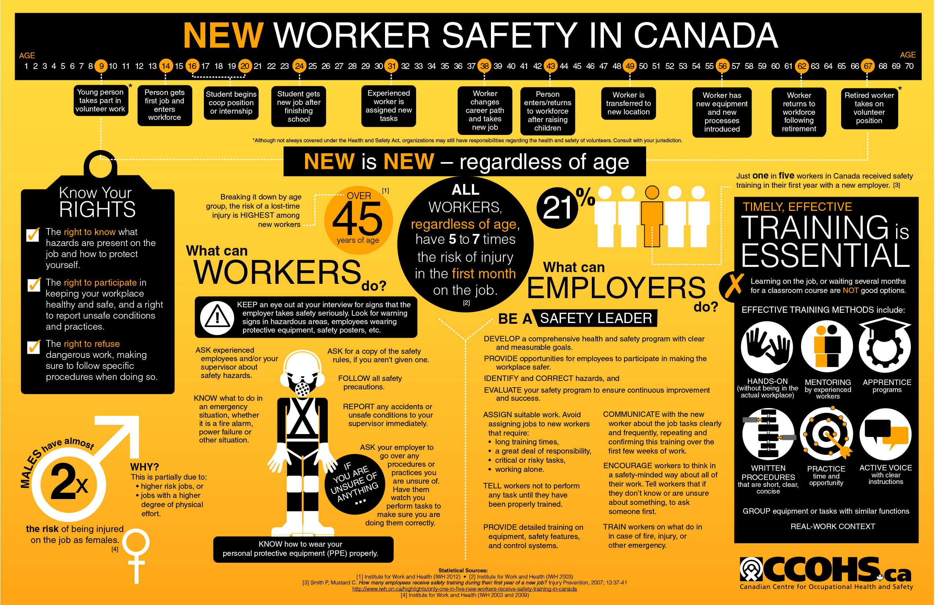

Slide 7
Key Takeaways
Students are at a higher risk or injury in the workplace
Students may not fully understand the hazards they face
Students must be supervised at all times
Students must not perform high risk tasks
Students must be trained for work activities they will try
Students are there to learn and gain interest in the industry and company
Students must follow the same safety rules including PPE use

